Slide 1
Car Information Management System(CIMS)
Sivaraj Sakthivel
Id:46008173

Slide 2
Objectives
Project Details
Use Case Diagram
Class Diagram
Sequence/Activity Diagram
Screen shots
Future Enhancements

Slide 3
Project Details
Car Information Management System (CIMS) helps Customers view the complete information about a given company’s car like Features, Engine & Performance, Safety, etc.
There Are two Actors Admin & Customers
Admin can has a login credentials. Admin Can perform Add,Modify,Delete,Search,Get details of all Cars.
Customer can perform Search operation based on Model Name of the car and will get all the features.
Customer Can also perform Search operation based on Manufacturer and Type.

Slide 4
Project Details(Continued)
Phase 1 : Using Console Application.
Phase 2 : Using ADO.NET using WPF.
Phase 3 : Using ASP.NET MVC.

Slide 5
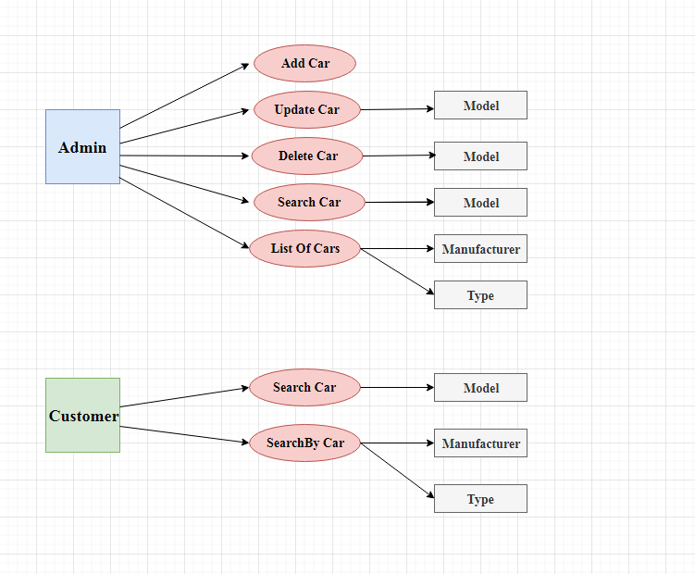
Use Case Diagram

Slide 6
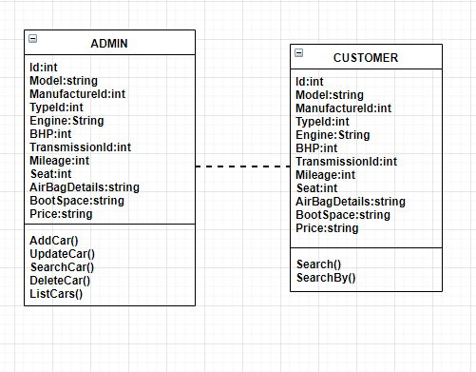
Class Diagram

Slide 7
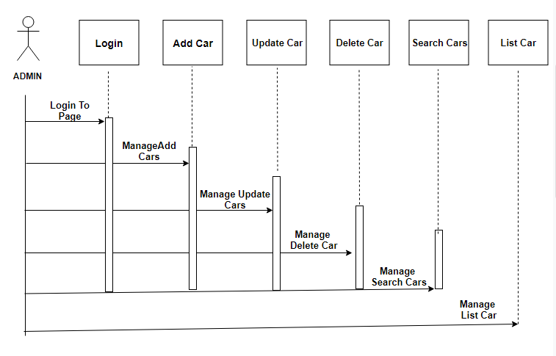
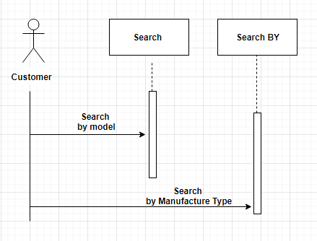
Sequence/Activity Diagram

Slide 8
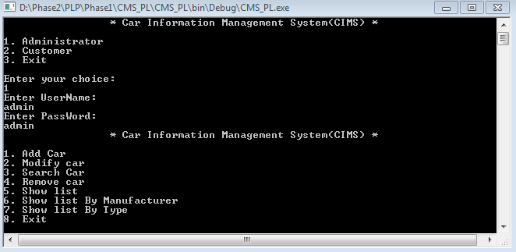
Screen shot – Phase1 Admin Login

Slide 9
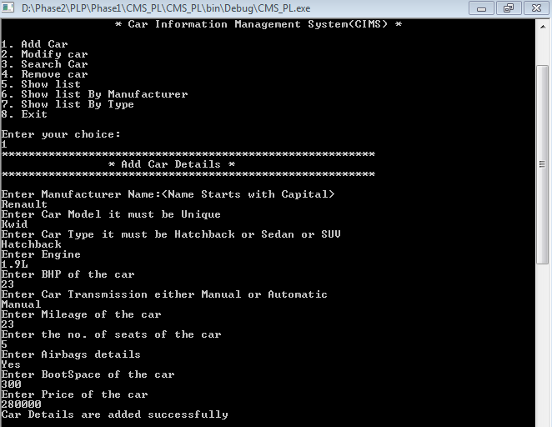
Screen shot – Phase1 - AddCarDetail

Slide 10
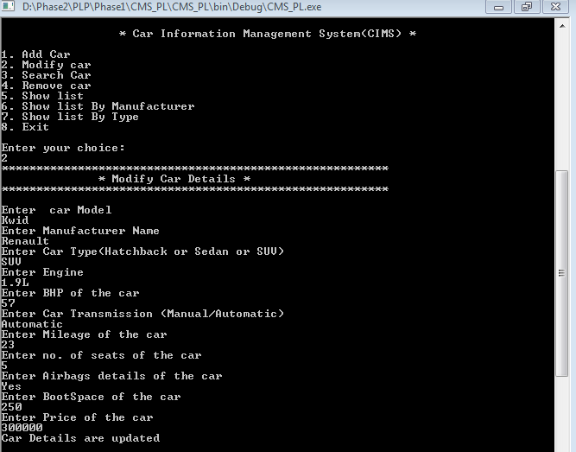
Screen shot – Phase1 – Update Car

Slide 11
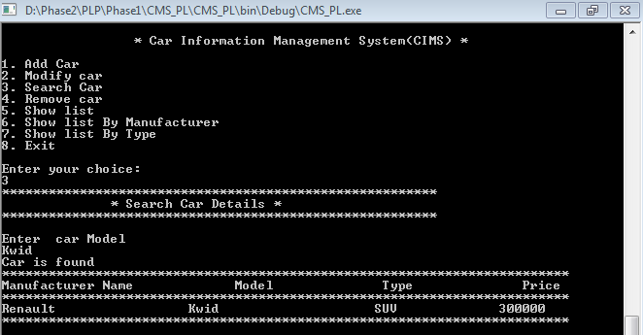
Screen shot – Phase1 - Search

Slide 12
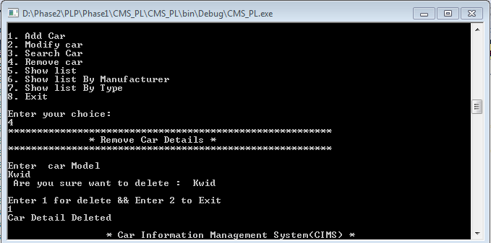
Screen shot - Phase1 - Delete

Slide 13
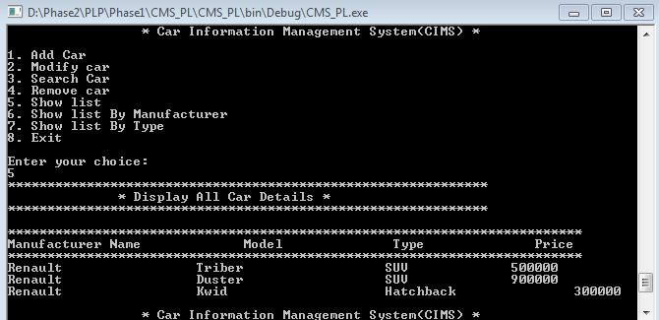
Screen shot - Phase1 – List Of Cars

Slide 14
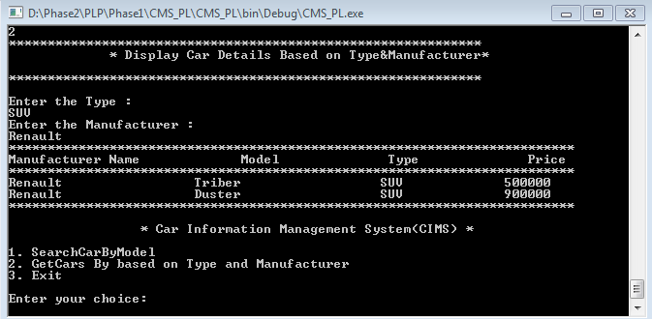
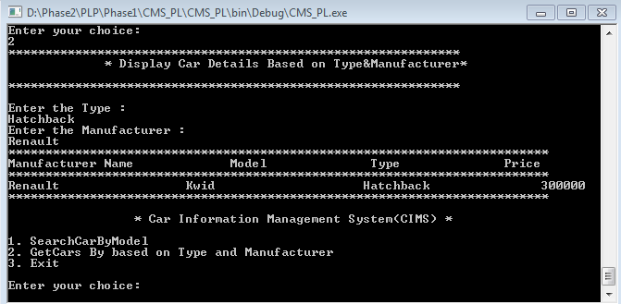
Screen shot – Phase1 - CustomerList

Slide 15
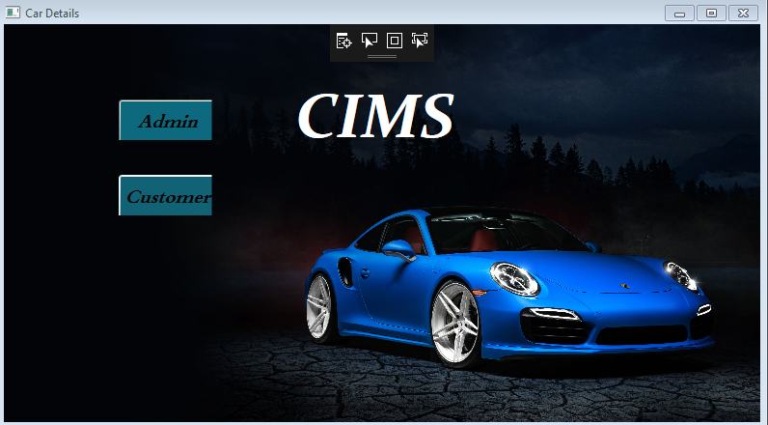
Screen shot – Phase2 - First Page

Slide 16
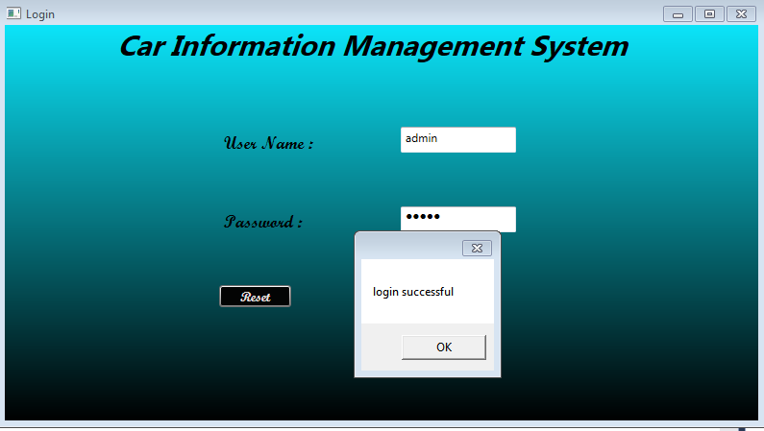
Screen shot – Phase2 – Admin Login

Slide 17
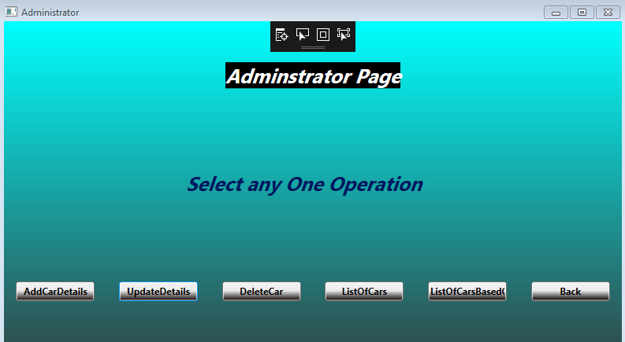
Screen shot – Phase2 – Admin Page

Slide 18
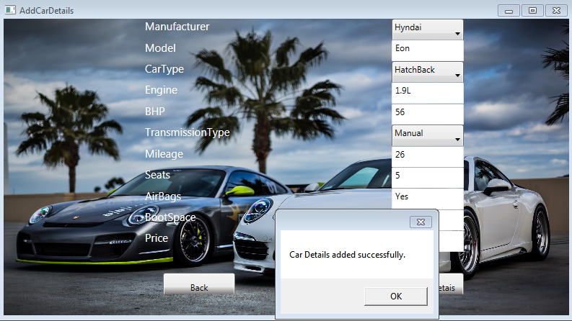
Screen shot – Phase2 - Add Car

Slide 19
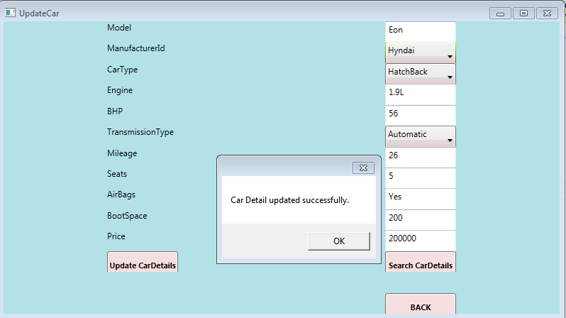
Screen shot – Phase2 - Update Car

Slide 20
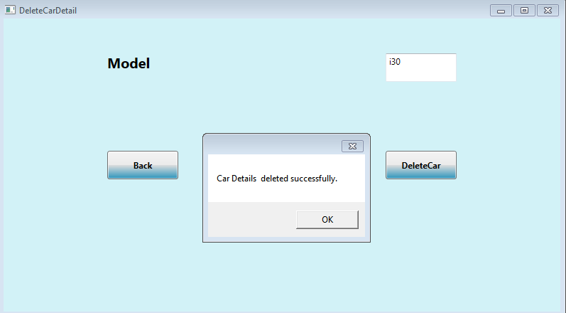
Screen shot – Phase2 - Delete Car

Slide 21
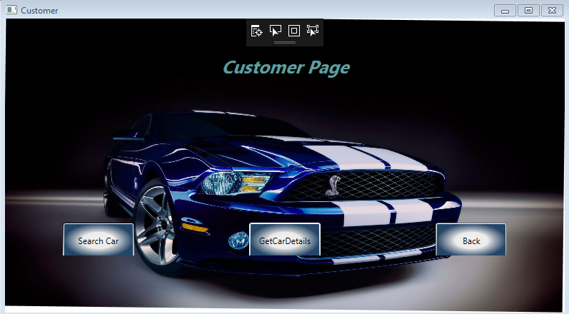
Screen shot – Phase2 – Customer Page

Slide 22
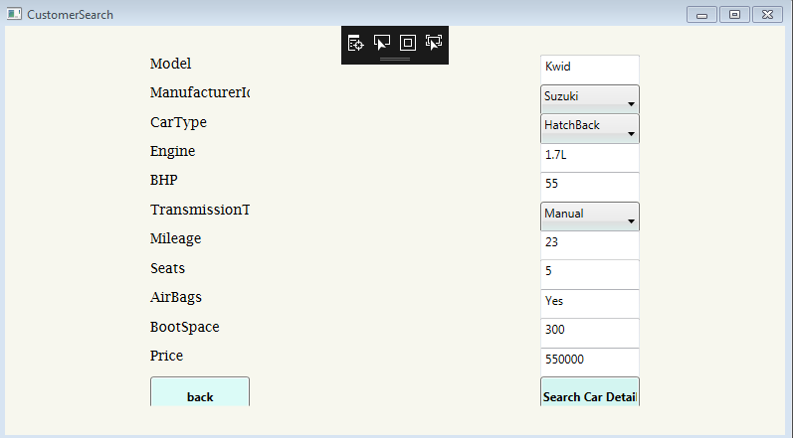
Screen shot – Phase2 - Customer Search

Slide 23
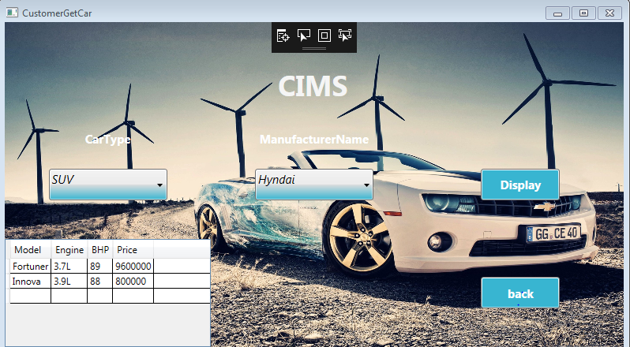
Screen shot – Phase2 - CustomerList

Slide 24
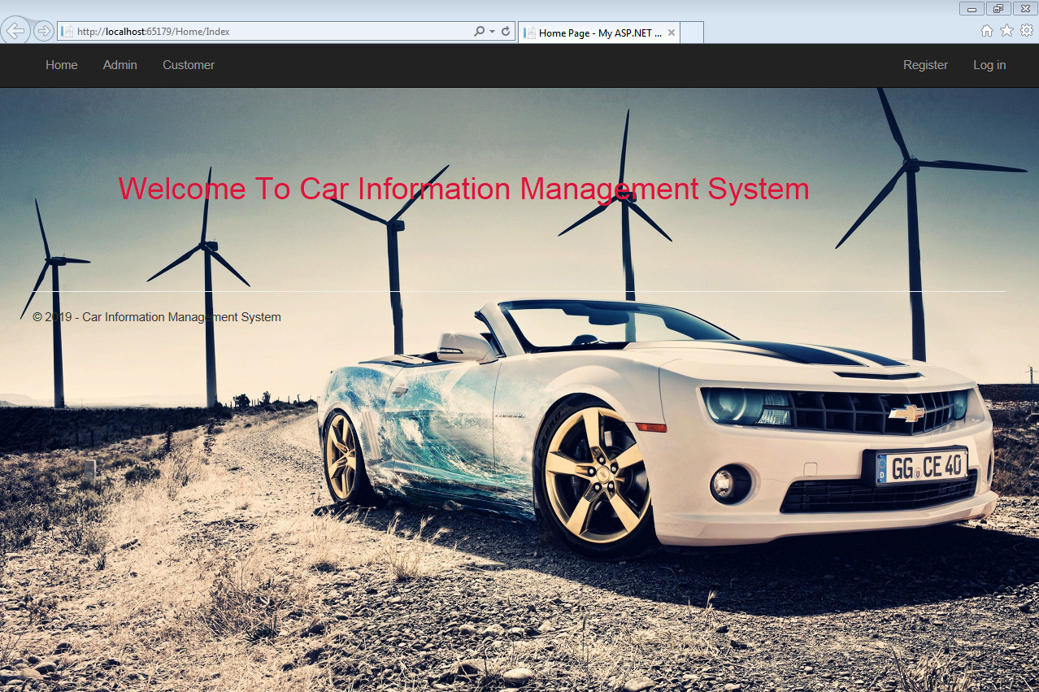
Screen shot – Phase3 - First Page

Slide 25
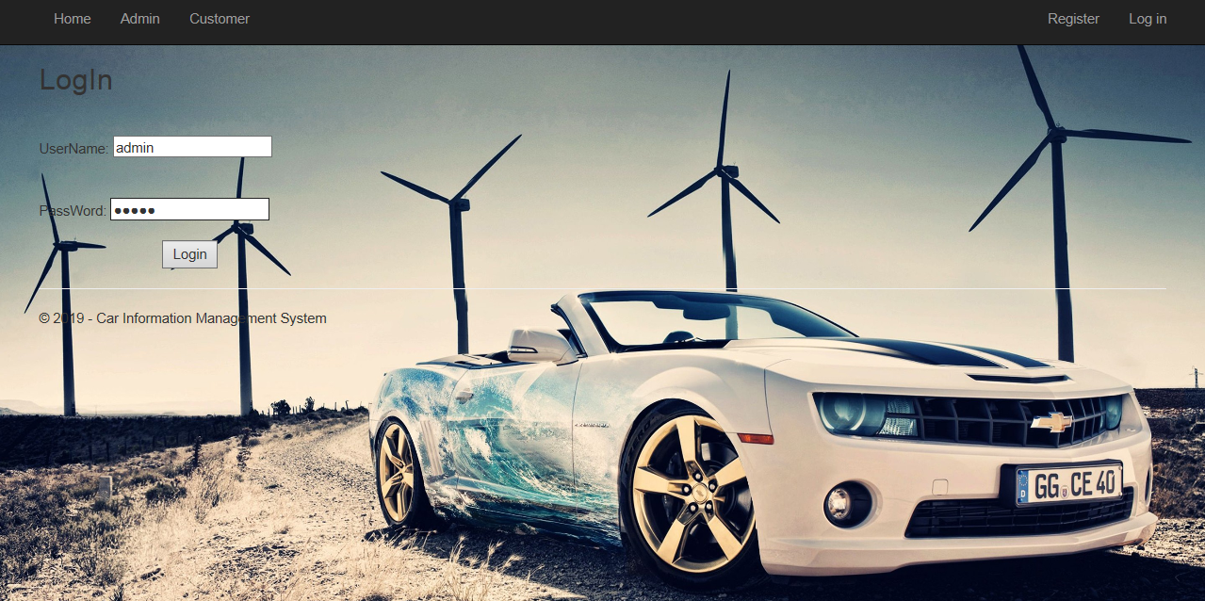
Screen shot – Phase3 – Admin Login

Slide 26
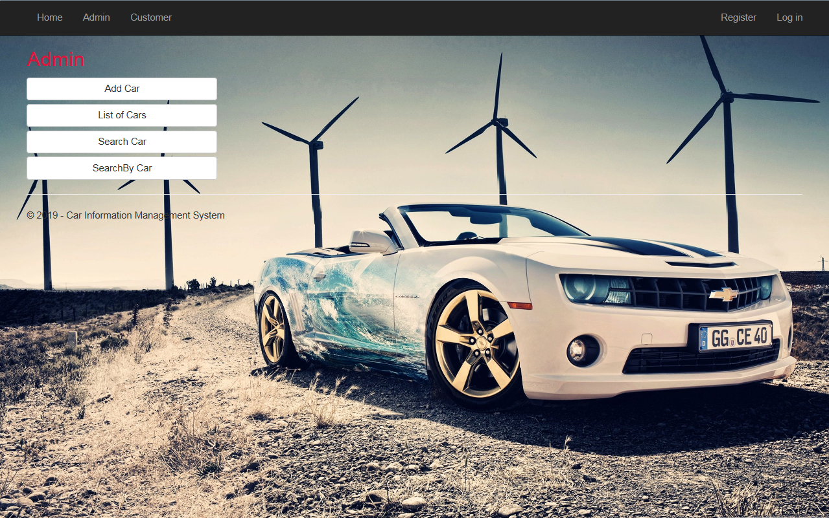
Screen shot – Phase3 – Admin Page

Slide 27
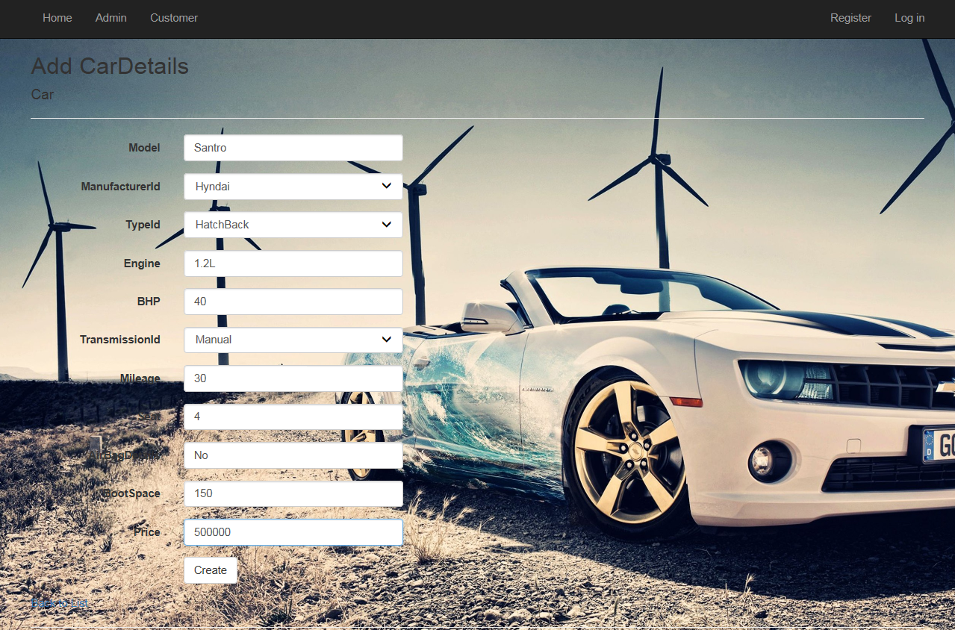
Screen shot – Phase3 - Add Car

Slide 28
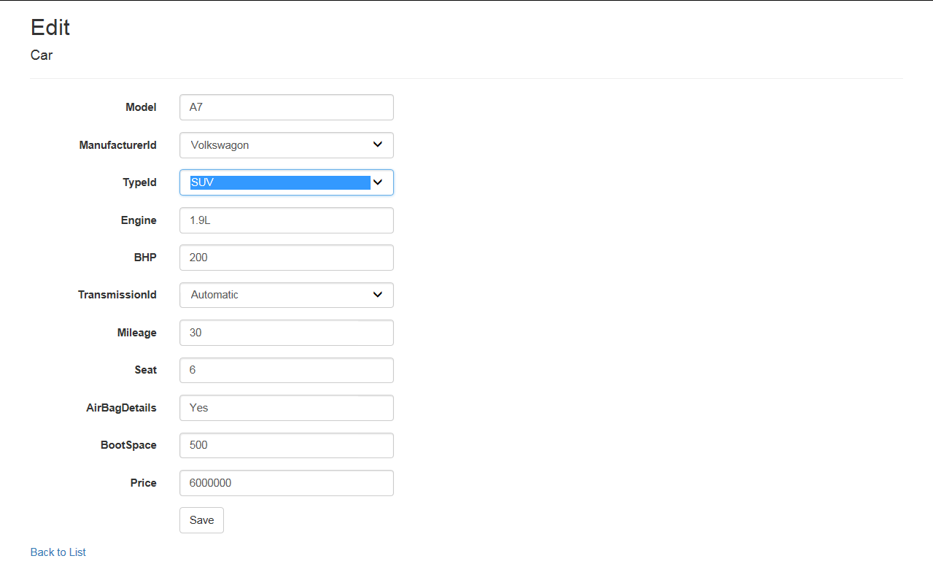
Screen shot – Phase3 - Update Car

Slide 29
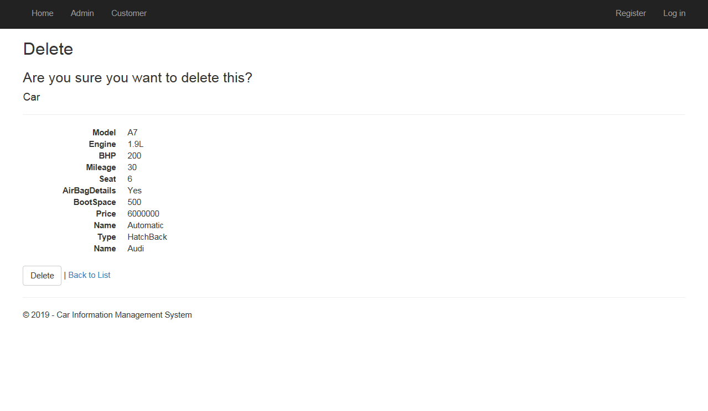
Screen shot – Phase3 - Delete Car

Slide 30
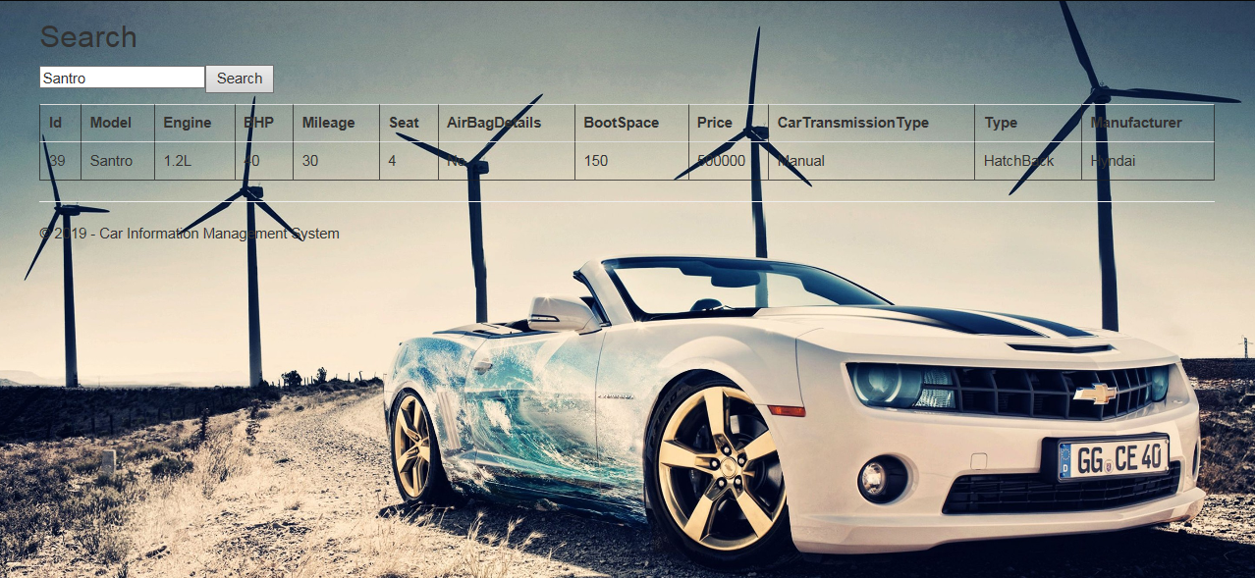
Screen shot – Phase3 – Search By Model

Slide 31
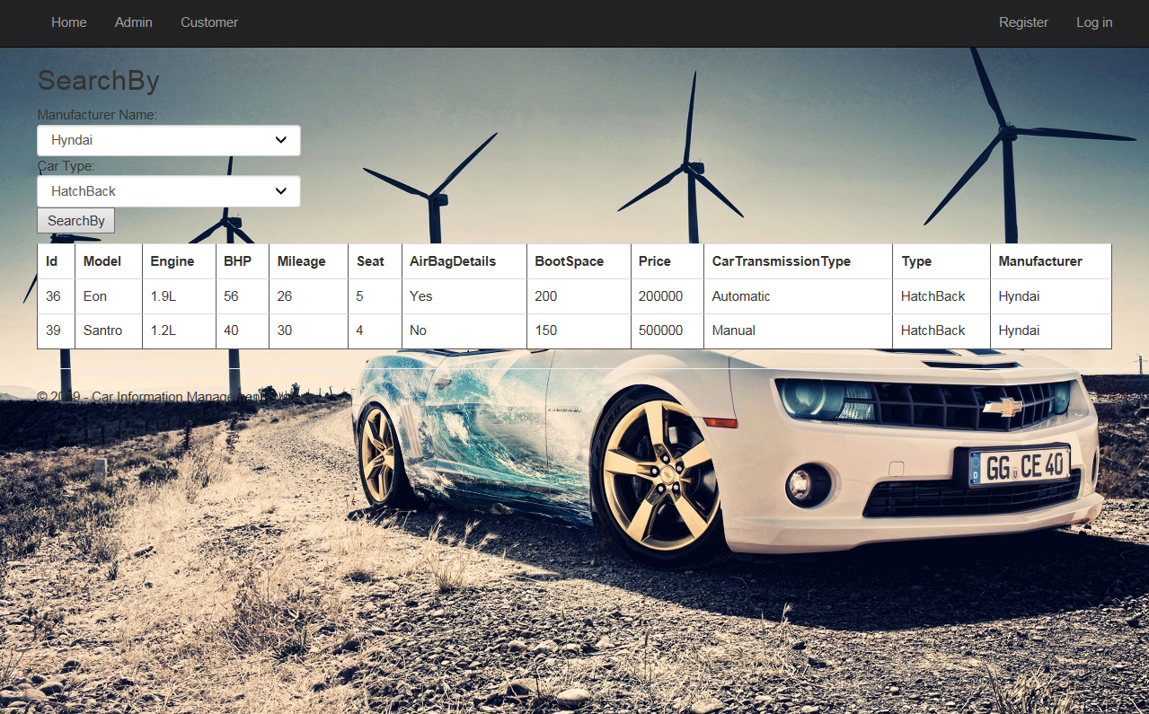
Screen shot – phase3 - Customer Search

Slide 32
Future Enhancements
UI Can be Improved
Database can be given for Login Credentials

Slide 33
Thanks

Slide 34
Q&A

